Slide 1

"Review-I of Major Project”
for E-4 2017 Admitted Batch
Submitted as part of Major Project.
M. Bhargavi (S171051)
B. Devaki (S170283)
P. Vinay kumar (S170528)
Under the Supervision of:
Asst. Prof. Ms. M. Roopa, M.Tech
Department of Computer Science and Engineering
Rajiv Gandhi University of Knowledge Technologies
Srikakulam – 532402

Slide 2
Extract Trends from Social Media Data Using Selenium Automation

Slide 3
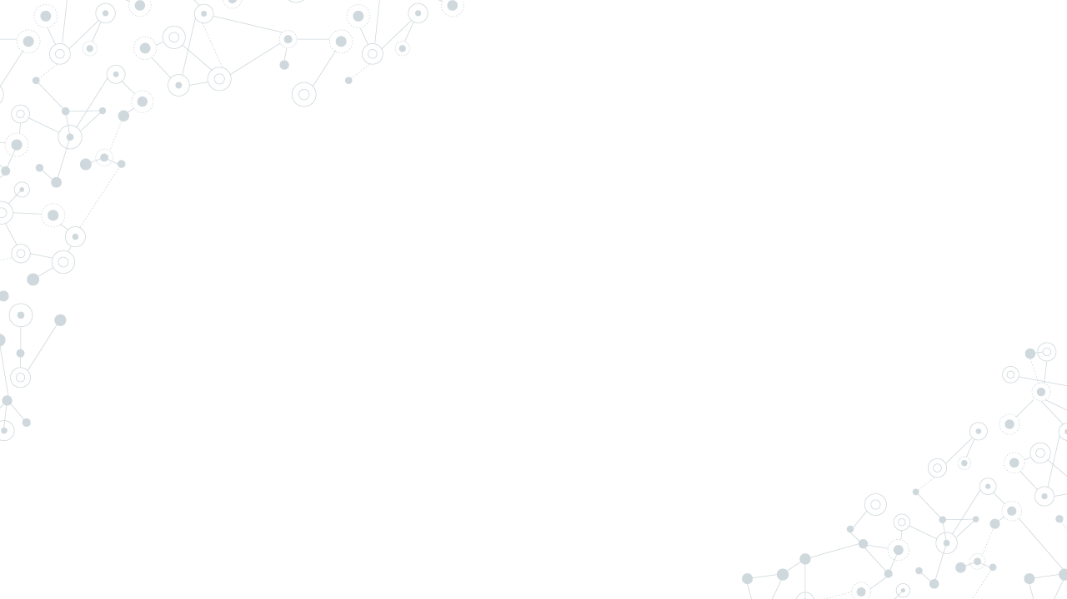
ABSTRACT:
Currently, the most relevant and popular Social Networks are Instagram, Twitter etc. These Social Networks were created to share posts, comments and opinions. This data is presented as images, short text strings containing different ideas expressed by real people and that can now use to extract trending products. Extracted trends are used to map with e-commerce websites like Flipkart, Amazon, etc. which provide information on trending products that people are talking about, so the retailers can source them to meet their needs. In other words, if they offer a more popular product, a larger audience will be willing to buy it.

Slide 4
OUTCOMES:
List of trending keywords
Sample images and respective links
Most trending first
Category, sub category (Ex: Category - Fashion, sub category – Women Western)
Create a mapping of extracted trending keyword(s) with E-Commerce website category, sub category, vertical and product attribute(s), search page links
From a trending keyword, creating a corresponding searchable term on E-Commerce which will lead to matching products

Slide 5
INTRODUCTION:
Nowadays trends are changing day by day, so identifying trends is very important because trend analysis helps understand how a business has evolved in various areas, especially research areas such as marketing where current business activities and practices take place. So, all we need is a place where trends are available. Social Networks have become an important environment for collective trends extraction. The interactions amongst users provide information of their preferences and relationships. This information can be used to measure the influence of ideas, or opinions, and how they are spread within the Network.

Slide 6
Proposed Approach
A three-tier architecture is used, with the layers,
Crawling for Dataset Creation
Trends Identification and Classification
Flipkart Relevant Smart Mapper
A top view of the approach is shown on the image,

Slide 7
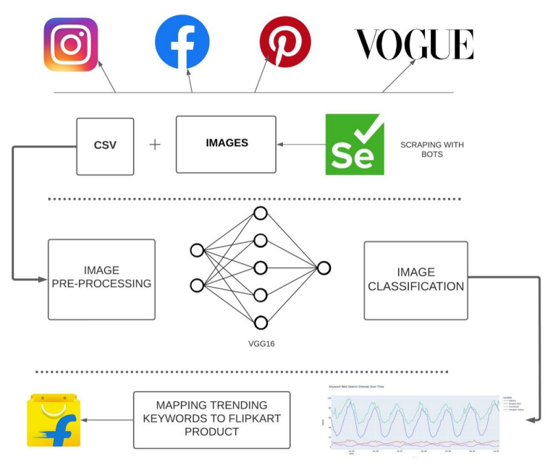


Slide 8
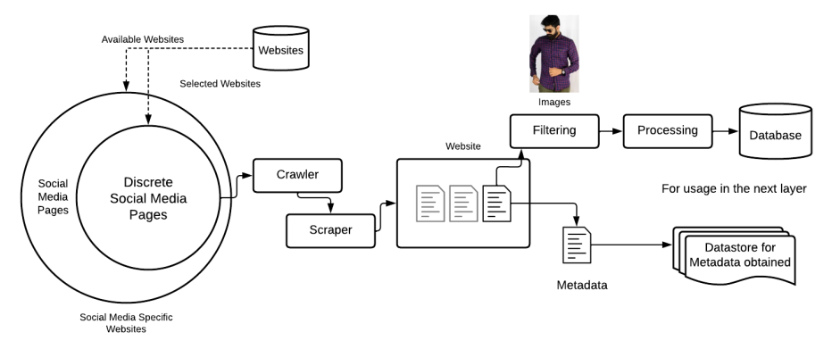
1. Crawling and Scraping
Crawling and Scraping social media websites for images and metadata. The workflow used for achieved this is displayed below.

Slide 9
2. Trends Identification and Classification
Crawling Trends Identification and Classification using a deep neural network based on the VGG16 architecture, and corroborating the trends with PyTrends API and Google Trends API.
• We make use of the VGG-16 architecture because it is one of the best models when it comes to image classifications, and consists of roughly 136 million parameters.
• As a result, we are able to classify and identify a large number of trends in the images – which can be easily scaled in the future.
• For images with unnecessary features such as human faces, arms, pets, etc., we use the YOLOv5 architecture to identify the “fashion” (clothes, footwear, etc.) and crop them out.
• We obtain the top trending fashion keywords from Google Trends API and PyTrends API and use it to corroborate/evaluate the result obtained.
• The described second tier is shown in the next slide

Slide 10
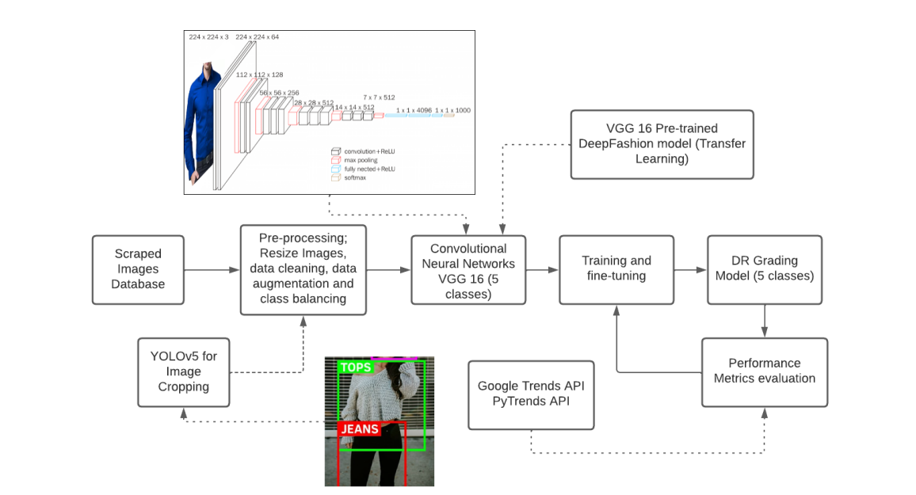

Slide 11
SCOPE OF RESEARCH WORK
A fashion retailer wants to source ongoing and upcoming fashion trends from major online fashion portals and online magazines in a consumable and actionable format, so that they are able to effectively and efficiently design an upcoming fashion product portfolio.
Extracted trends are used to map with e-commerce websites like Flipkart, Amazon, etc. which provide information on trending products that people are talking about, so the retailers can source them to meet their needs. In other words, if they offer a more popular product, a larger audience will be willing to buy it.

Slide 12
ANALYSIS OF EXISTING METHODS/ MODELS/ ALGORITHMS
Google Trends is a website by Google that analyzes the popularity of top search queries in Google Search across various regions and languages. The website uses graphs to compare the search volume of different queries over time.
Amazon’s search suggest feature is a way to uncover trending product and category keywords.

Slide 13
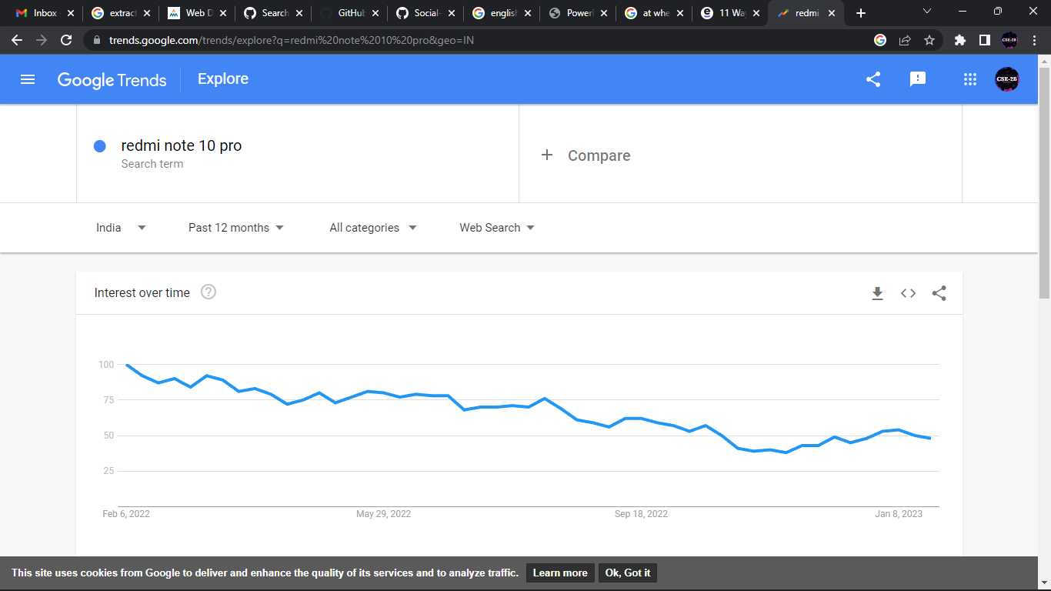

Slide 14
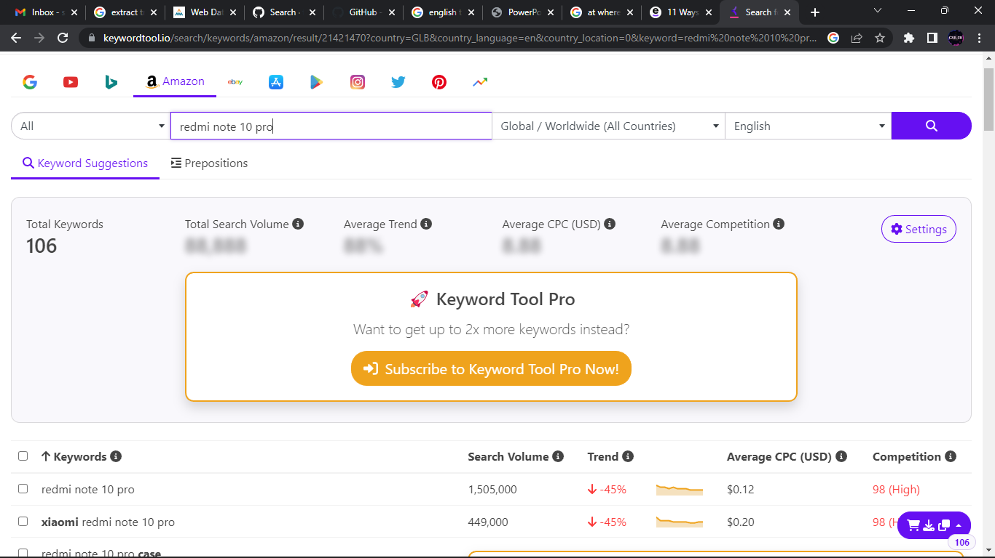

Slide 15
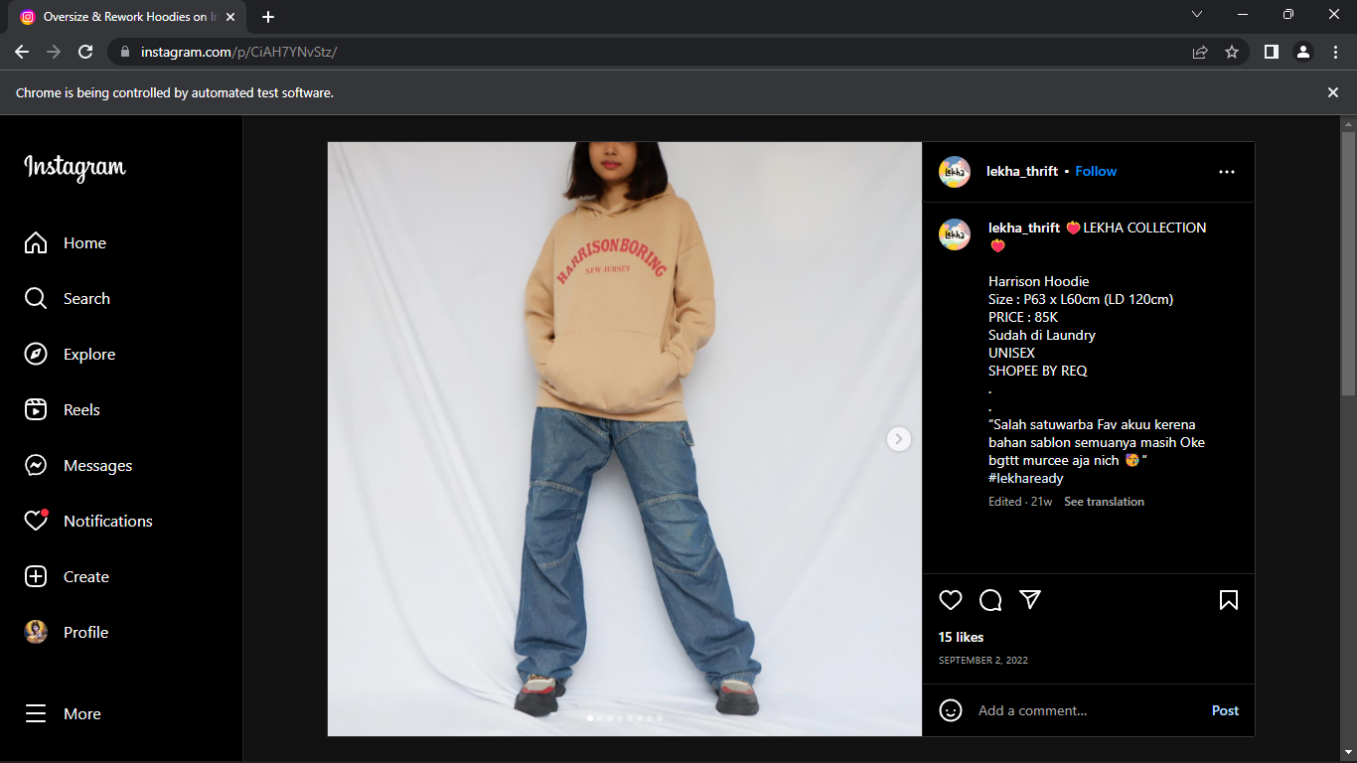
Screenshots of output

Slide 16
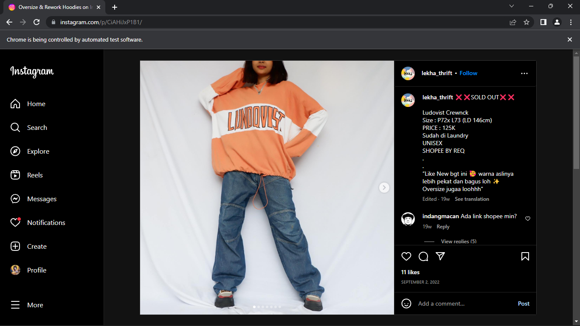

Slide 17
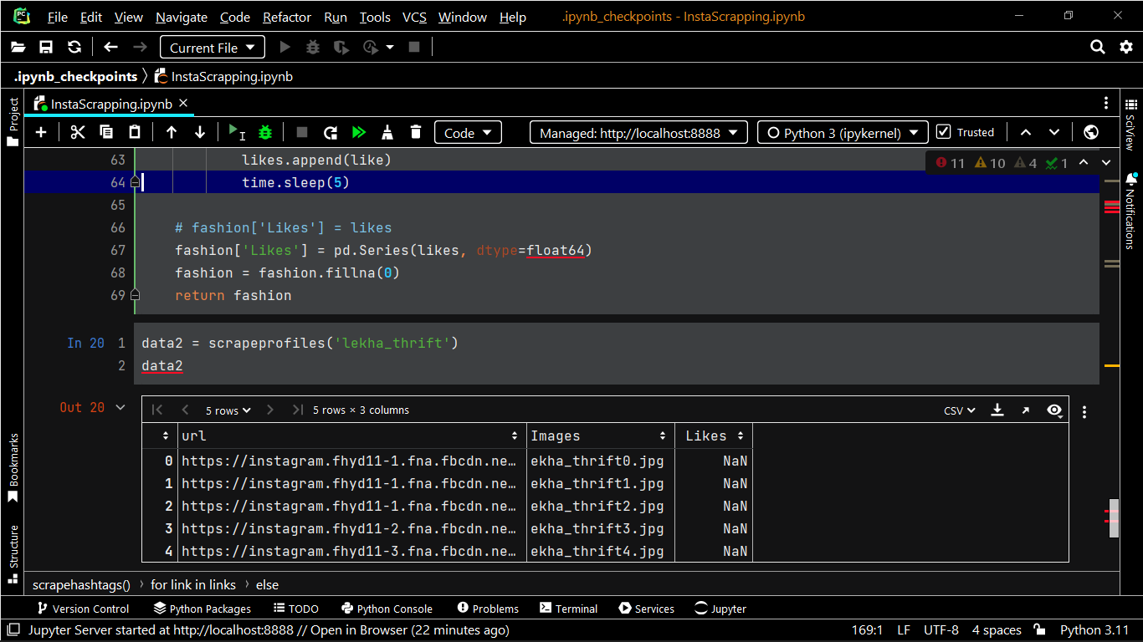

Slide 18
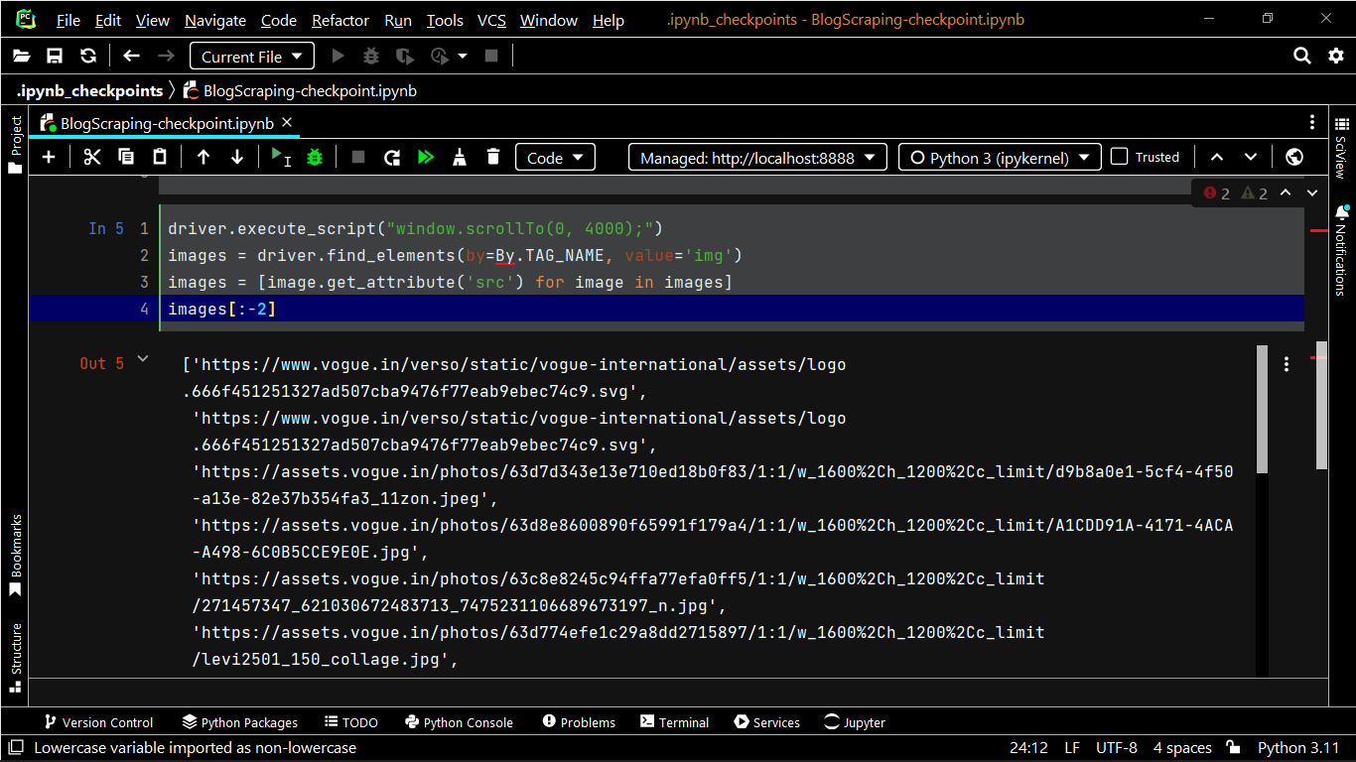

Slide 19
CONCLUSION:
Social media has become a major fashion influencer for today's generation. All of us surf internet and it happens a lot that we come across some products that we wish to buy but can't find it. This model solves this problem.
It extracts top trending posts from social media and then forms a searchable query on E-Commerce and shows all the similar products which are then compared to the initial product.

Slide 20
Thanks!

